Slide 1

Introduction to Data Mining
src: https://www.aapc.com/blog/wp_aapc_content/uploads/2015/09/Page44.jpg

Slide 2

Data-driven Decision Making
❑ An approach to business governance that values decisions that can be backed up with verifiable data
Not by intuition or “gut feeling”, but by “data”
Reference: http://whatis.techtarget.com/definition/data-driven-decision-management-DDDM
Src: https://www.matrixgroup.net/thematrixfiles/wp-content/uploads/2015/12/Data-Analytics.jpg

Slide 3
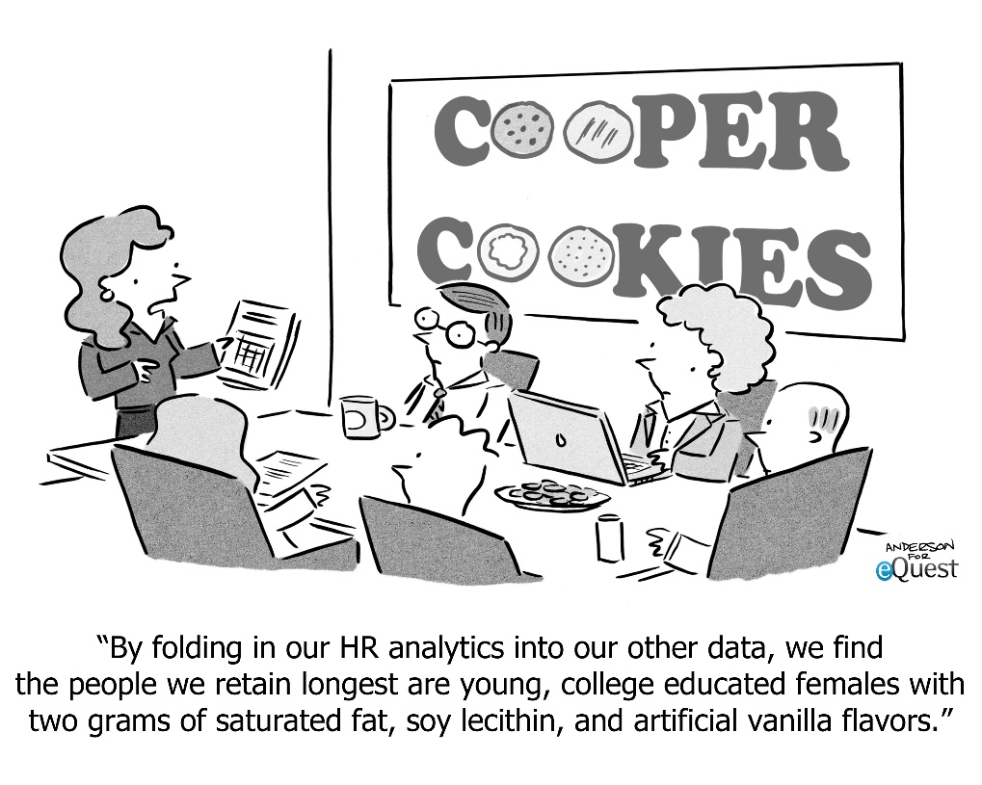
Data-driven Decision Making
❑ What are the differences?
Objectivity
Consistency
Interpretability & Insight
Planning
Src: http://www.equest.com/wp-content/uploads/2014/03/equest2014-4-EmployeRetention.jpg

Slide 4
Data, Database, and Information
❑ Data: collected facts and figures
Data require interpretation to become information
❑ Database: collection of computer files containing data
Narrower definition comprises only relational databases (RDB)
❑ Information: comes from analyzing data
Raw data converted useful
Reference: https://en.wikipedia.org/wiki/Data_(computing), evans 2013

Slide 5
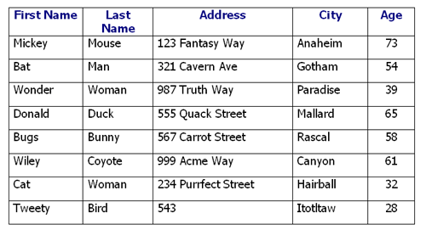
Data, Database, and Information
❑ Data can be either structured or unstructured
Structured Data
Src: http://cloudpeermedia.com/wp-content/uploads/2015/12/figure-1.jpg

Slide 6
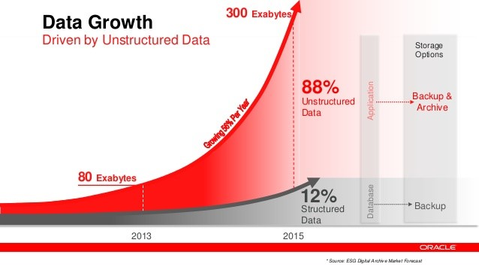
Data, Database, and Information
❑ Data can be either structured or unstructured
Unstructured Data: text, image, video, audio, …
Src: https://blog.xively.com/wp-content/uploads/2016/03/Data-Growth_Data-Everywhere-Blog.jpg

Slide 7
Data, Database, and Information
❑ Most datasets are comprised of tables (with row/columns)
Think of Excel spreadsheets, RDB tables, or R/Pandas Dataframes
Each row is a record (or data instance/observation)
Each column is a field (or attribute/feature)
Sometimes, each row is distinguished by index (ID) and each column by header (or column index)
Header
ID | First Name | Last Name | Phone | City
A12 | Jane | Reid | 555-2142 | San Francisco
A13 | John | Townsend | 541-5521 | Portland
A14 | Mike | Smith | 424-1187 | Boston
A15 | Elizabeth | Taylor | 479-1179 | Seattle
Feature
Data instance
Index

Slide 8
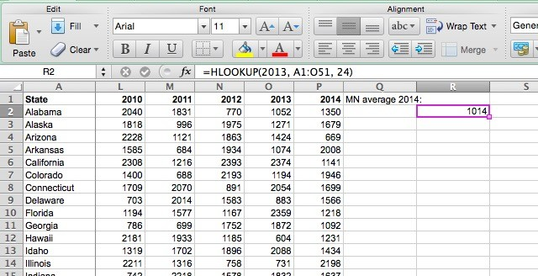
Data, Database, and Information
Header
❑ Example: Excel Spreadsheet
Index
Data instance
Feature

Slide 9
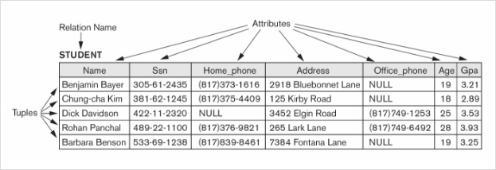
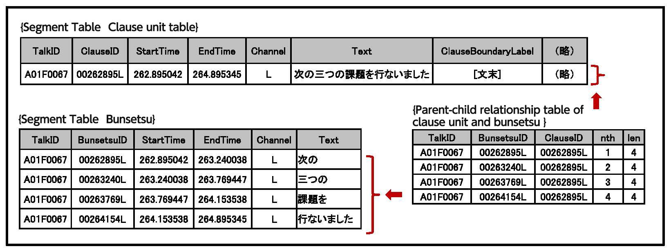
Data, Database, and Information
❑ Example: Relation (table) in relational database

Slide 10
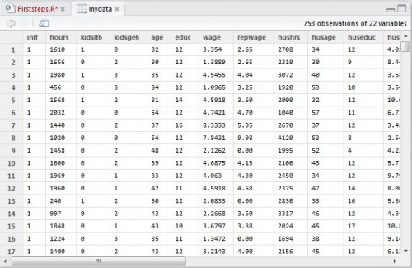
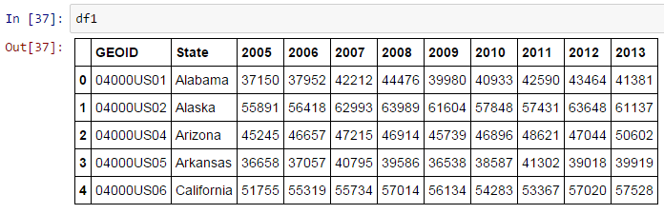
Data, Database, and Information
❑ Example: R/Pandas Dataframe

Slide 11

Data Mining Process
❑ Cross-industry standard process for data mining (CRISP-DM)
src: https://upload.wikimedia.org/wikipedia/commons/thumb/b/b9/CRISP-DM_Process_Diagram.png/1024px-CRISP-DM_Process_Diagram.png

Slide 12
Data Mining Process
❑ Cross-industry standard process for data mining (CRISP-DM)
Business understanding: understanding the project objectives and requirements from a business perspective, and then converting this knowledge into a data mining problem definition, and a preliminary plan designed to achieve objectives
Data understanding: starts with an initial data collection and proceeds with activities in order to get familiar with the data, to identify data quality problems, to discover first insights into the data, or to detect interesting subsets to form hypotheses for hidden information
Data preparation: all activities to construct the final dataset (data that will be fed into the modeling tool(s)) from the initial raw data.
Modeling: various modeling techniques are selected and applied, and their parameters are calibrated to optimal values.
Evaluation: thoroughly evaluate the model, and review the steps executed to construct the model, to be certain it properly achieves the business objectives
Deployment: the knowledge gained will need to be organized and presented in a way that is useful to the customer
Reference: https://en.wikipedia.org/wiki/Cross-industry_standard_process_for_data_mining

Slide 13
Data Mining Process
❑ Related techniques & methodologies
Data (Pre)processing: key step in DM. Includes cleaning, data reduction, normalization, transformation, feature extraction and selection, etc.
- “Necessary condition” for gaining insights from data
- Heavily performed in data preparation stage, but can be performed in other stages as well
Data Visualization: techniques used to communicate data or information by encoding it as visual objects (e.g., points , lines or bars) contained in graphics
- Goal is to communicate information clearly and efficiently to others

Slide 14
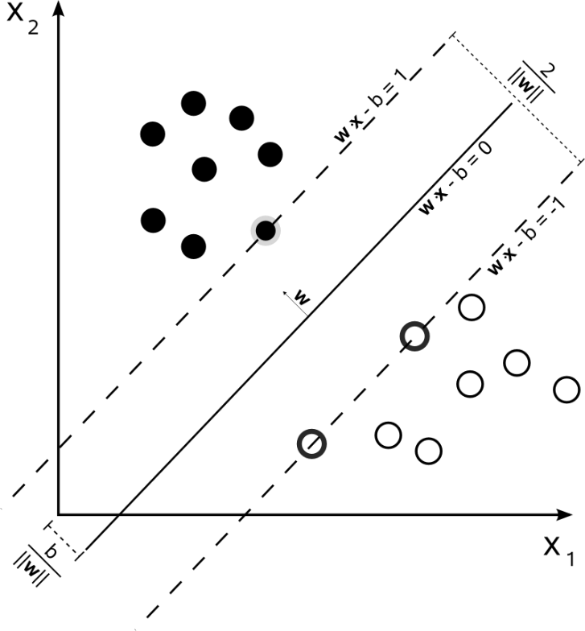
Data Mining Process
❑ Related techniques & methodologies
Data Analysis: Analyzing and modeling data using statistical techniques, (computational) learning techniques, querying, etc.
Recognizing “patterns” from dataset
Machine learning: giving computers “the ability to learn without being explicitly programmed”
src: https://upload.wikimedia.org/wikipedia/commons/2/2a/Svm_max_sep_hyperplane_with_margin.png

Slide 15
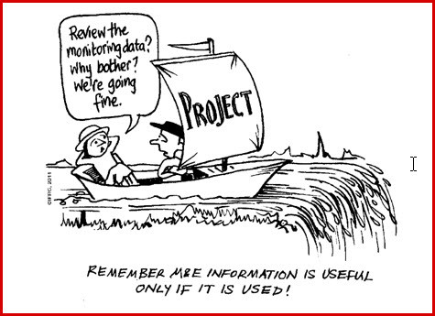
Data Mining Process
❑ Related techniques & methodologies
Interpretation & Application: Interpreting and applying the results in business context is more important than modeling and analysis itself
Objectives and metrics for DM project should be clarified at outset
Extracting insights from results is crucial! Keep focusing on business impact!
Engineer vs. Data analyst
src: https://smartprimaryed.files.wordpress.com/2014/12/chaplowe2.jpg?w=788

Slide 16
Focus of the course
❑ Data mining ZERO TO ALL
Start from scratch, make small ones, and make larger and important ones in the end
No programming/statistics/mathematics preliminaries required!
❑ Technique + Business Insight
Start with techniques, but not “technique for technique”
Always remember, it is the business impact that matters!
❑ Practicality & Learning by Doing
Do not fret with marginal improvements in terms of efficiency, performance, technicality, etc.
We do not dive into details of algorithms, computer mechanics, data structures, etc. Instead, we try to learn by messing up with real-world data
Practical coding + extracting business insight

